Slide 1
CENG317 HARDWARE PRESENTATION: Liquid Crystal Display (LCD) and Numeric Keypad
Presented by Jan Stanley Go
January 15, 2018

Slide 2
INTRODUCTION
A summary of why this device and how this links to CENG319 and next semester’s Computer Systems Project course

Slide 3
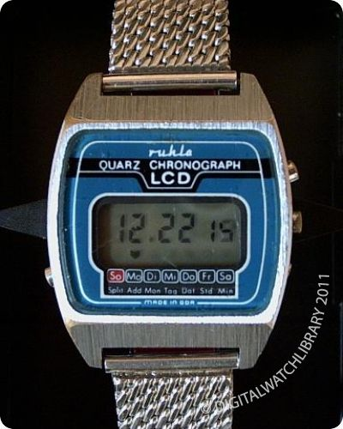
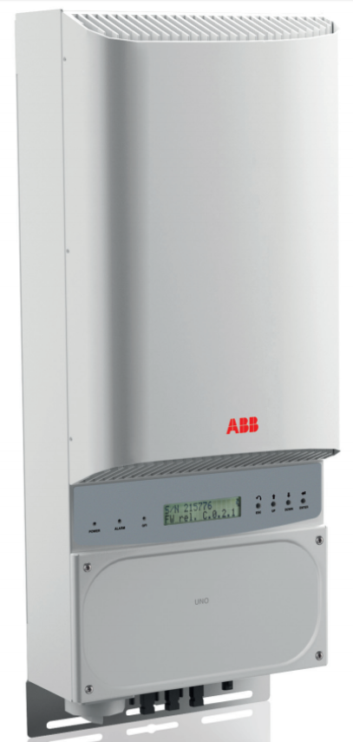
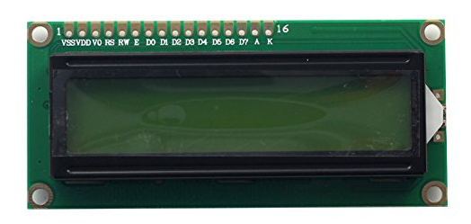
The Liquid-Crystal Display (LCD)
LCDs display information
Used on almost every device in some form that deals with digital information

Slide 4
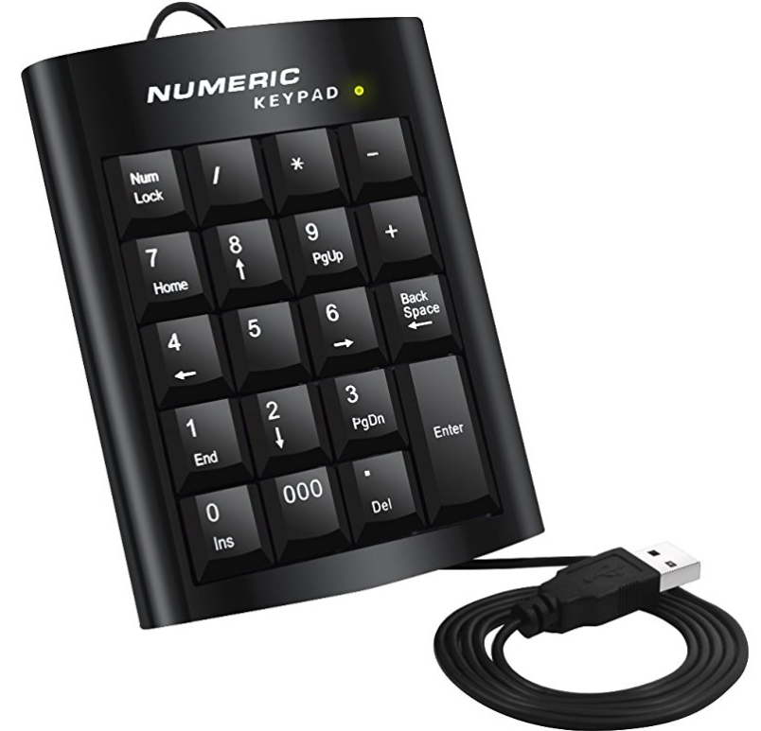
Numeric Keypad
Allows a user to input numbers, used mainly in calculations on the computer.

Slide 5
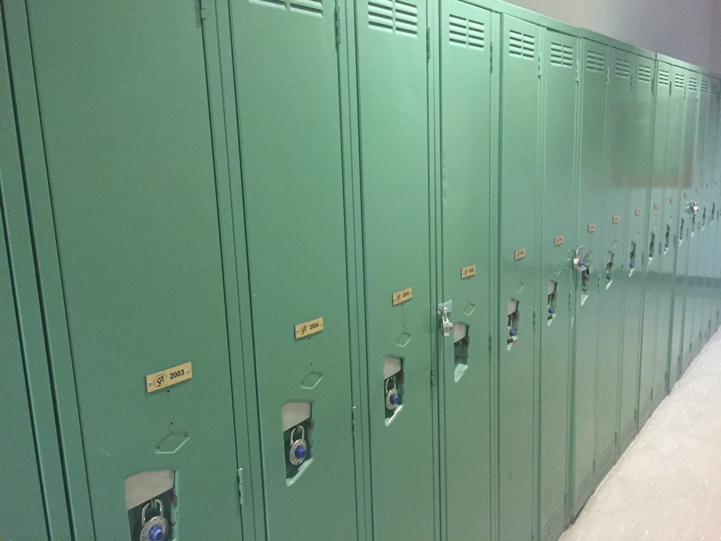
How does this relate to the Computer Systems Project?
For next semester, I will be working in a team to create a Locker Automation System™ which seeks to help automate the locking/opening of your typical locker door, and for that the LCD project will be used to provide information to the user. There will also be a numeric keypad to allow the user to navigate through the display options/input their unlock PIN manually

Slide 6
BUDGET
How much did I end up spending on this project?

Slide 7
List of components:
Raspberry Pi kit
Raspberry Pi 3 B
Power supply
Ethernet cable
Case
HD44780 LCD
USB Numeric Keypad (for inputs)
Breadboard
Male-to-female and male-to-male jumper cables

Slide 8
Breakdown of Costs
Component Name | Component Cost | Component Supplier
Raspberry Pi kit | 79.95 | Buyapi.ca
Breadboard | 0.00 | (came with Parts kit)
Male-to-female jumper cables | 3.45 | Buyapi.ca
Male-to-male jumper cables | 3.95 | Buyapi.ca
HD44780 LCD* | 5.00 | A1 Electronics
USB Numeric Keypad** | 14.99 | Amazon.ca
HD44780 16 x 2 LCD Module White Characters Blue Backlight*** | 6.76 | Amazon.ca
*The LCD itself is soldered on to a board, and as A1 Electronics is a surplus store, the display probably came from an old device as spare parts.
** You can probably find it for cheaper (and better build quality)
*** Optional if you choose to order online instead of going to A1 Electronics and dive in to a pile of electronic junk

Slide 9
Schedule

Slide 10
How long should it take to work on this project?
Acquiring parts (1-5 days estimate)
Ordering from Amazon (1 day)
Going to A1 Electronics (1/2 day)
Ordering from Buyapi.ca (3 days)
Unsure about how long it took since I ordered the parts back in 2016
Connecting the device (one afternoon at most)
Raspberry Pi setup
Flashing an OS shouldn’t take long, same with installing necessary programs/libraries. It should take one afternoon including procrastinating
LCD display setup
Wiring is quick if you have a reference for the pinouts up an ready. Around 5 minutes
USB numeric keypad setup
Most USB numeric keypads are plug and play, it should literally take you 2 seconds to get this working, 3 if you plug the USB in the wrong way
Programming
Once the libraries and programs are set up, coding will not be too tough (as Adafruit’s libraries work wonderfully with the HD44780 and their library is easy to understand)

Slide 11
Build

